Slide 1
Search & Rescue
Rashad Abdulkhaligov
VS7VSR@inf.elte.hu

Slide 2
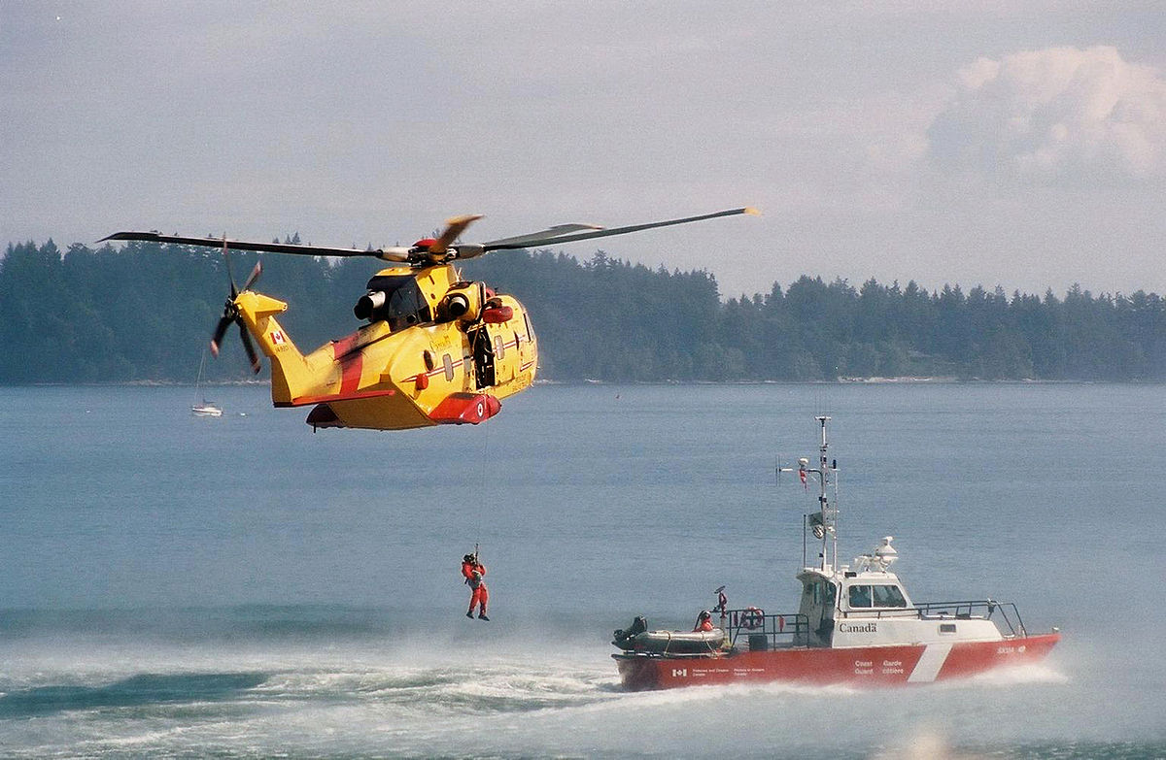
Example Project
Goal:
Develop advanced, AI-driven multi-agent systems for Search and Rescue operations that synergize robotics and emergency response techniques to maximize efficiency and effectiveness in life-saving missions during disaster scenarios.
Task:
Create an AI model that coordinates multiple autonomous agents (robots/drones) to efficiently locate and assist survivors in diverse and dynamic disaster environments, ensuring quick response times and optimized resource allocation for maximum life-saving impact.
Image(s)

Slide 3
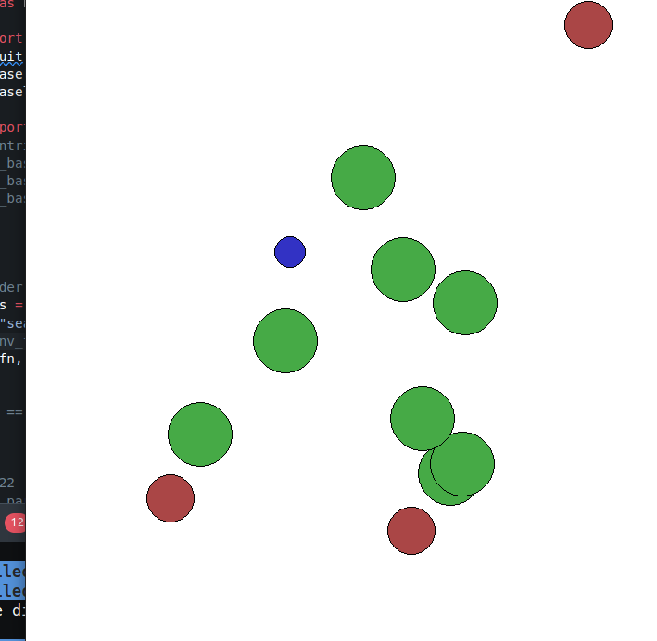
Environment
PettingZoo
2D
Round shape
2 agent type
1 Victim
3 Rescuer
1 obstacle type
8 Trees
Image(s)

Slide 4
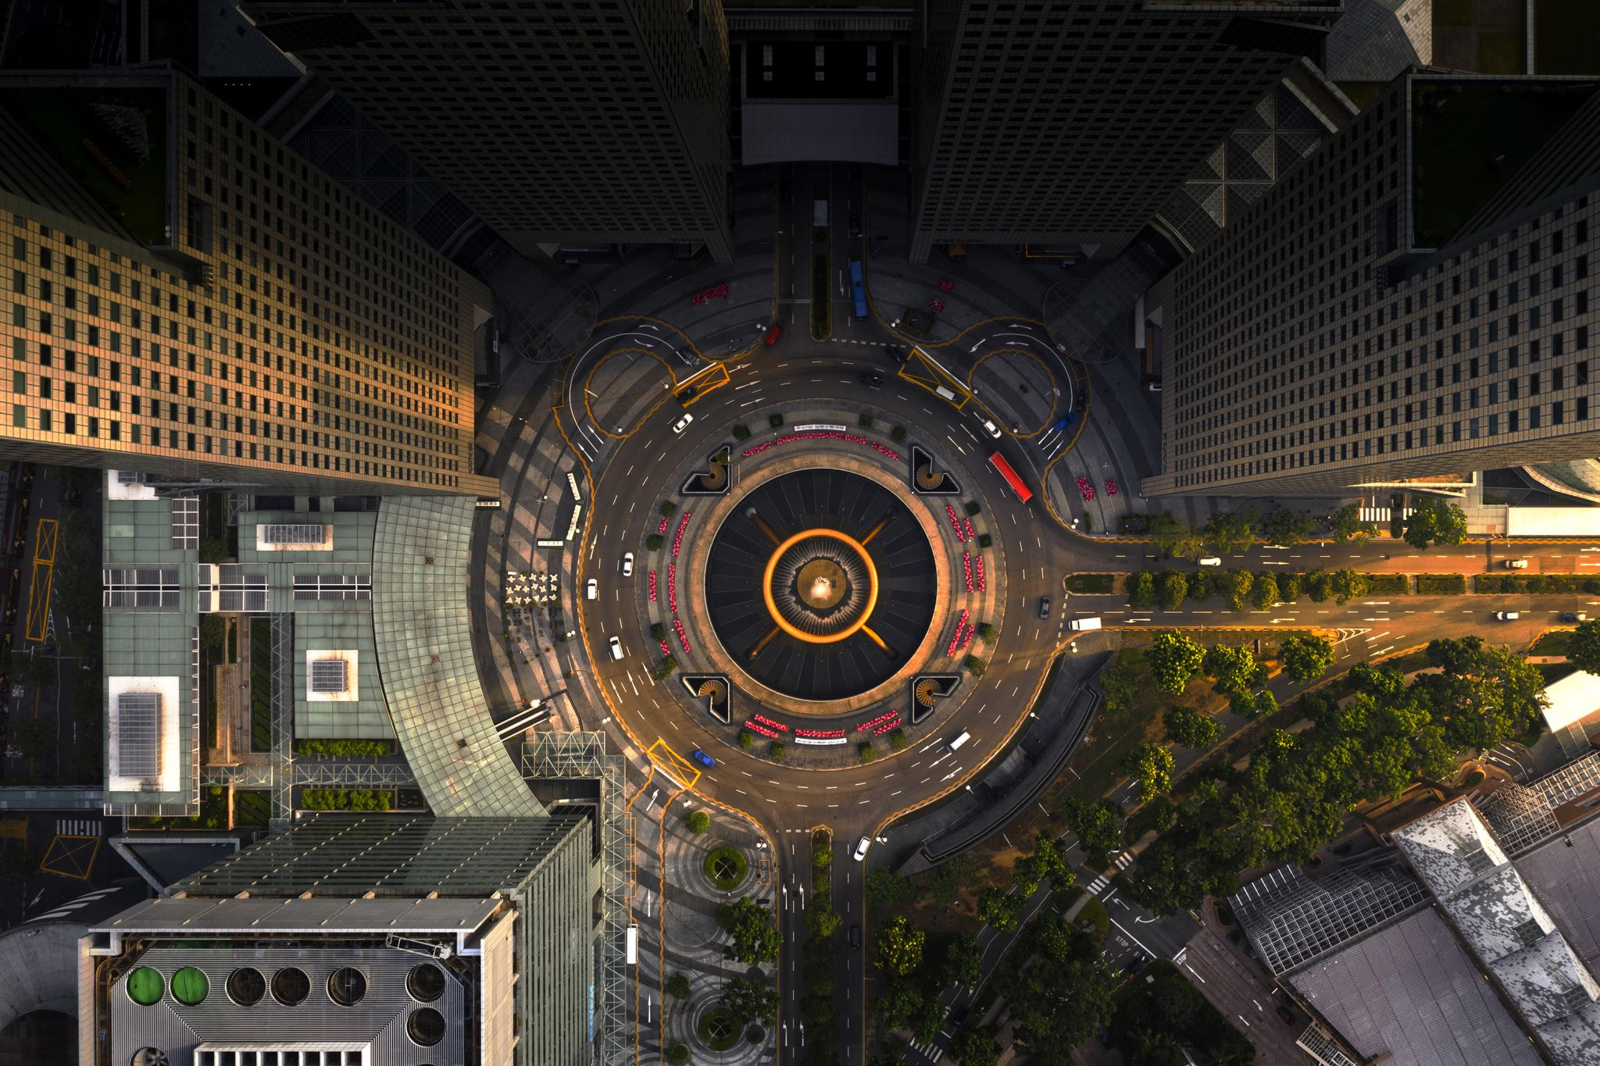
Observation spaces
Distances and relative positions of the three closest non-boundary landmarks to the agent.
Relative positions and velocities of other agents. If an agent is blocked by an obstacle, a placeholder position is used.
The agent's own velocity and position.

Slide 5
Action spaces
Move Up
Move Down
Move Left
Move Right
No action

Slide 6
Models and Policies
Models
MLP
LSTM
Policies
PPO
RecurrentPPO
Policy optimization
Reward
Model
Action
Observation
Backpropagation
Environment

Slide 7

Rewards
Agents (Non-Adversaries):
Penalized for being near adversaries.
Rewarded (+40 points) for rescuing victims.
Penalized for nearing or exiting the screen boundaries.
Adversaries:
Penalized for being distant from agents.
Rewarded (+40 points) for capturing agents.
Overall, this strategy motivates agents to rescue and avoid adversaries, while adversaries are encouraged to pursue agents, creating a competitive environment suitable for training AI in complex scenarios.

Slide 8
Evaluation metrics
Number of iterations
Number of collisions
Rewards

Slide 9
Results Test
Test/comparison description
Average Reward Overview:
The average total reward across all games and agents is 6,732.45.
Average Reward per Agent per Game:
Adversary 0: 417.54
Adversary 1: 611.45
Adversary 2: 324.50
Agent 0 (Good Agent): 1,339.49
Total Rewards Accumulated:
Adversary 0: 4,175.36
Adversary 1: 6,114.51
Adversary 2: 3,245.02
Agent 0 (Good Agent): 13,394.89

Slide 10
Conclusion and Further Work Example
Conclusion
Scalable RL algorithm
Parallel execution for real-time
Further Work
Experiments in more complex environments
Hybrid RL model

Slide 11
Thank You for Your attention!
Rashad Abdulkhaligov
VS7VSR@inf.elte.hu
Questions?

